Slide 1
www.gloscitymission.org.uk

Slide 4
THERE ARE LOTS OF CAUSES OF HOMELESSNESS
Family arguments
Loss of job
Debt
Drugs and alcohol problems
Being in and out of prison

Slide 5
Smile and treat people like humans
WHAT CAN YOU DO?
Give what you can directly to people
Blankets
Food
Hot drinks
Raise awareness/Fundraise
Donations to charities
Clothes
Toiletries
Food/tea/coffee/cup-a-soup/Hot choc

Slide 6
Pot Noodles
Individual wrapped biscuits
Tinned Mushrooms
Chopped tomatoes
Bolognaise Sauce
Curry sauce
Tinned Sweetcorn
Tinned Tuna
Jam
Tinned Rice pudding
Bars of chocolate
Cans of coke
Tinned fruit, Including fruit cocktail
Ready Made Custard
Sugar
Coffee (sachets or jars)
Dried Fruit

Slide 7
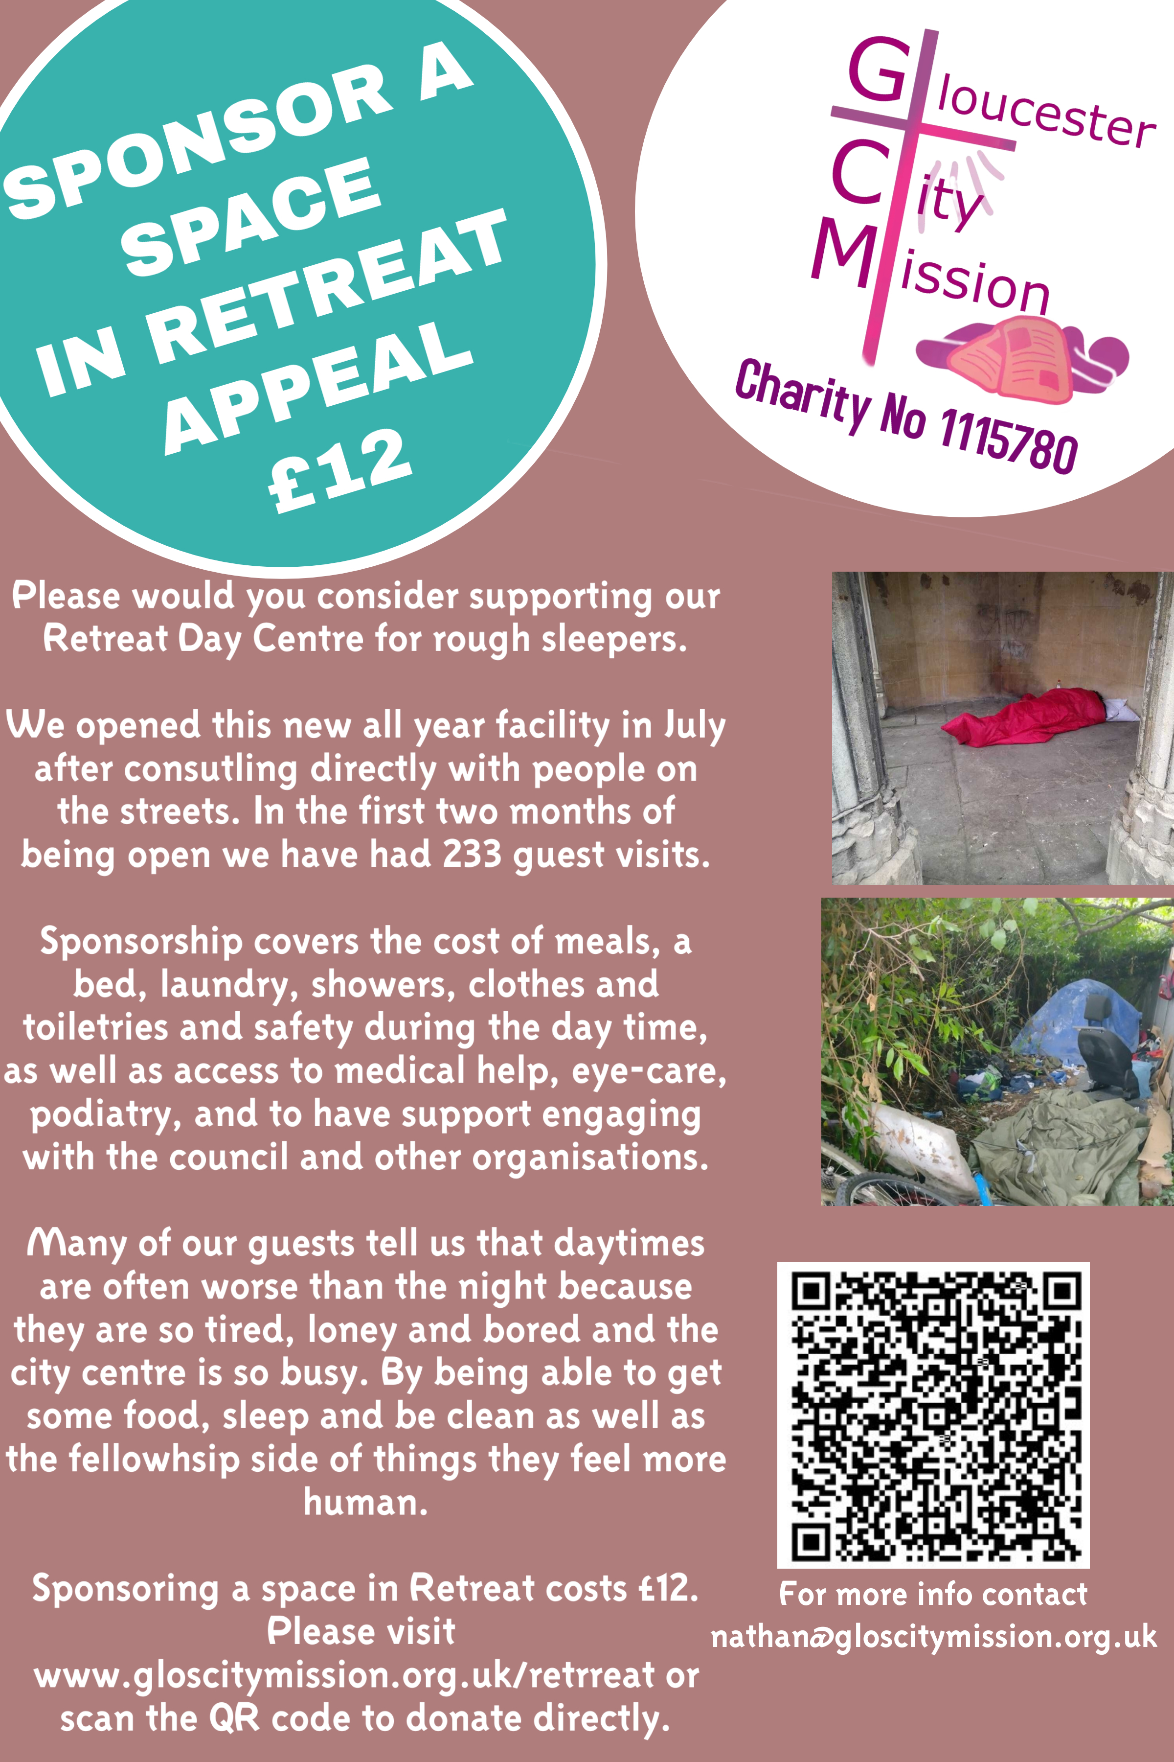

Slide 8
www.gloscitymission.org.uk

